Slide 1

Farmer John’s Market
Revature Project 0
John Kear

Slide 2
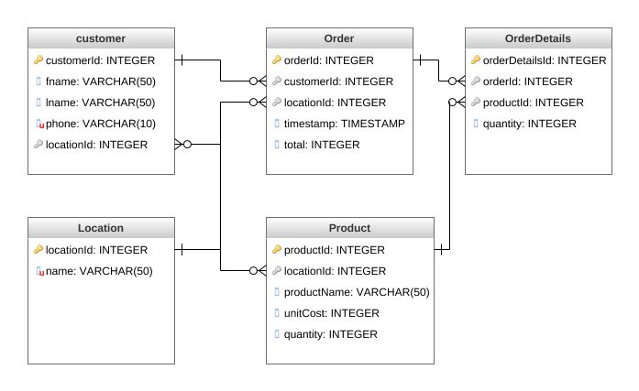
Relational Database UML
Notes:
1NF – No duplicative columns, separate tables for related data, use of PKs
2NF – Remove duplicative data, put subsets in new tables, link with FKs
3NF – No column relies on another for its value (non-transitive dependency)

Slide 3
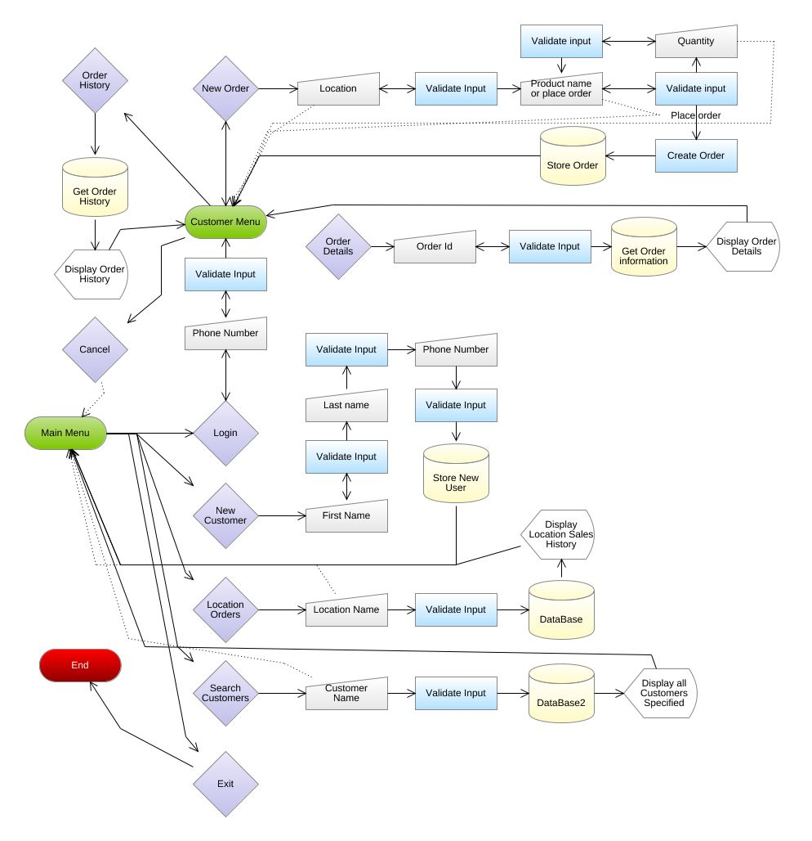
Program Flow Diagram
Notes:
Do not go through these steps!
Just show this briefly, not enough time in 5 minutes!

Slide 4
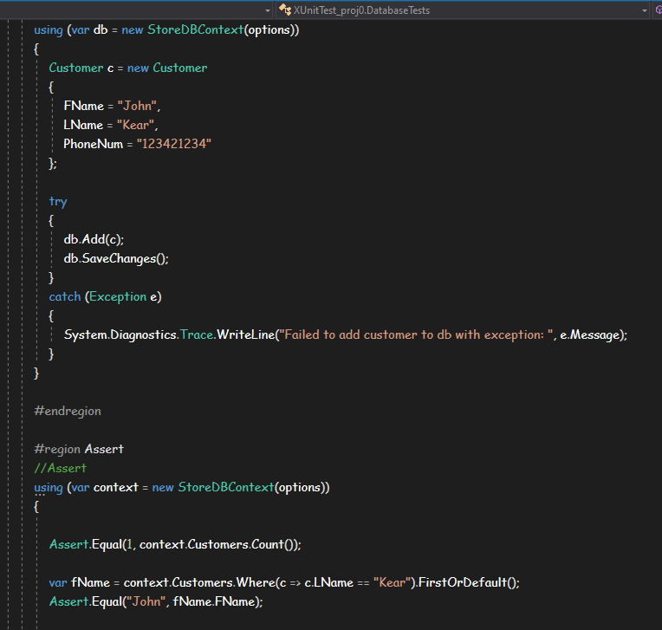
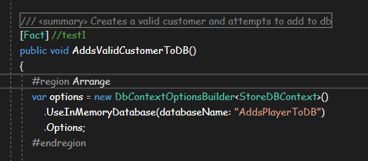
Unit Test Cases
Arrange
Setup In Memory database
Act
Create and add customer to In Memory database
Assert
Test for expected values

